Slide 1
ghayarly
Omar Shaher
Amr Ashraf
Ibrahim Abouzeid
Supervised By: Dr. Mohamed Mostafa
Eng. Amr Daba

Slide 2
content
Introduction
Purpose
Intended Audience and competitors
Product scope
Overall Description
Product perspective
User classes and characteristics
Operating Environment
System Features
Wireframe
ERD
Github

Slide 3
introduction
Ghayarly is a professional auto service center that operates to provide top quality car services and premium tire brands for all car models.
We are always fully dedicated to help drivers everywhere to enjoy the safest, most comfortable and pleasurable possible drives.

Slide 4
purpose
Professional Auto Services: Ghayarly aims to offer professional and high-quality automotive services. This includes maintenance, repairs, and diagnostic services for a wide range of car models
Premium Tire Brands: It provides customers with access to top-tier tires, ensuring safety, performance, and longevity.
Comprehensive Product Range: offers a diverse range of automotive products, including car batteries, oils, and accessories. This allows customers to find all their automotive needs under one roof.
Innovation and Technology: is committed to integrating the latest technology, tools, and equipment in its services.
Customer Satisfaction: is fully dedicated to helping drivers enjoy the safest, most comfortable, and pleasurable driving experiences possible. Customer satisfaction is a central focus, and the company aims to exceed customer expectations in every interaction.
Global Brand Quality: By combining the superb quality of global brands with outstanding service expertise that delivers excellence in both products and customer service.

Slide 5
Intended audience and competitors
Development Team: To guide system development and implementation.
Management: To understand project scope, objectives, and system functionalities.
Stakeholders: To grasp operational and service aspects concerning customers and partners.
End Users (Drivers): To comprehend available services, products, and accessibility of Ghayarly.
Competitors
Traditional Auto Parts Stores: Brick-and-mortar stores providing a similar range of products.
Other E-commerce Platforms: Local or international websites catering to the Egyptian market.
Car Dealerships: Offering parts and services for their specific brands.
Local Mechanics and Garages: Some may have their own supply chains for parts. Marketplaces with Diverse
Offerings: General e-commerce platforms that also sell car parts among various other products.

Slide 6
Product Scope
Service Offerings: Maintenance, repair, and diagnostic services for cars of various makes and models.
Tire Brands: Exclusive access to top-tier brands like Bridgestone, Firestone, and Michellin.
Additional Products: Car batteries, oils, and accessories from premium global brands.

Slide 7
Overall description
Ghayarly, within the product perspective, aligns with industry trends, fosters interactions across various stakeholders, and aims to positively impact customers, suppliers, and the automotive service landscape in Egypt through innovation, accessibility, and service excellence.

Slide 8
Product perspective
Industry Context: Ghayarly operates within the dynamic and competitive automotive service industry.
Customer Interaction: Ghayarly engages customers through multiple touchpoints, including physical stores, an online platform.
Supplier Interaction: Collaborations with leading global tire brands and automotive product manufacturers to ensure access to premium quality products.
Operational Interaction: Coordination among service centers, online platforms to facilitate seamless service delivery.
Customer Impact: Enhancing the driving experience through professional services, superior tire selections, and convenient access, ensuring safety, comfort, and satisfaction.
Industry Impact: Setting benchmarks for service quality, innovation, and customer-centric approaches within the automotive service sector in Egypt.
Stakeholder Impact: Providing growth opportunities for suppliers, fostering employment, and contributing to the automotive service ecosystem.
Integration: Integration of advanced technology and cutting-edge tools to streamline operations and provide efficient services to customers.
Expansion: Continued expansion of service centers and an online presence to reach more customers, ensuring broader accessibility.
Technological Integration: Embracing technological advancements to offer digital solutions, personalized services, and efficient operations.
Customer-Centric Approach: Prioritizing customer needs by offering diverse services and products through multiple channels.
Sustainability Initiatives: Implementing eco-friendly products in line with the growing demand for sustainability in the automotive industry.

Slide 9
User classes and characteristics
1. Drivers/Customers:
  Use physical service centers for repairs, maintenance, and tire installations.
  Browse the online platform for tire purchases, accessories, and scheduling appointments.
  Utilize mobile service units for on-location installations or emergency services.
2. Service Technicians:
  Perform repair and maintenance tasks at service centers.
  Utilize system interfaces for accessing service history, diagnostic tools, and parts inventory.
3. Store Managers/Staff:
  Manage store operations, inventory, and customer inquiries at physical locations.
  Use system interfaces for managing appointments, tracking sales, and coordinating services.
4. Online Platform Users:
  Browse the website for tire options, accessories, and service offerings.
  Register accounts, schedule appointments, and make purchases online.

Slide 10
Operating Environment
Physical Environment
Service Centers/Stores:
  Facilities: Physical locations across major cities in Egypt housing repair, maintenance, and service facilities.
Customer Locations:
  On-site Services: Providing services at customer residences, workplaces, or roadside locations.
Digital Environment
Online Platform:
  Website: User-friendly interface for browsing tire options, accessories, and scheduling appointments.
  E-commerce System: Facilitating online purchases, order processing, and payments.
System Interfaces:
  Service Management System: Tracking service history, appointments, and customer interactions.
  Inventory Management System: Managing tire inventory, stock levels, and product availability.

Slide 11
System features
User-Friendly Interface: An intuitive system allowing customers to schedule service appointments conveniently.
Service Tracking: Providing real-time updates on service progress and completion.
History Access: Allowing customers to access and review past service records and maintenance history.
Tire Catalog: A comprehensive catalog showcasing available tire brands, sizes, and specifications.
Recommendation Engine: Offering tire recommendations based on vehicle types and driving conditions.
User Accounts: Secure user profiles for personalized experiences and order history.

Slide 12
wireframe
Home Page
Login
Cart

Slide 13
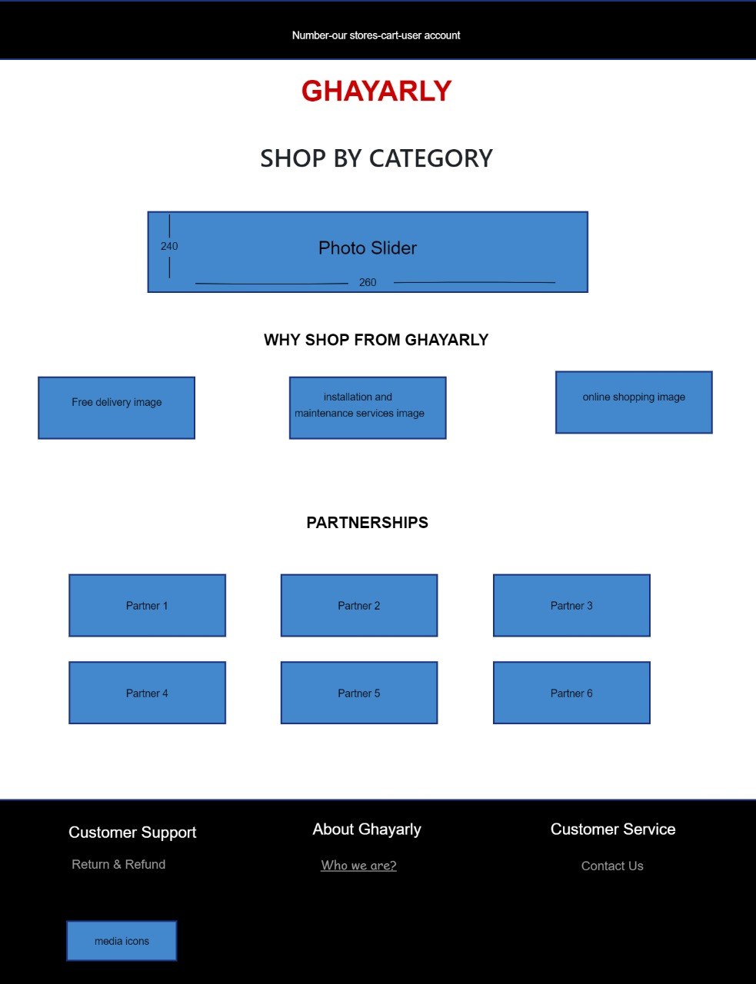
Home page

Slide 14
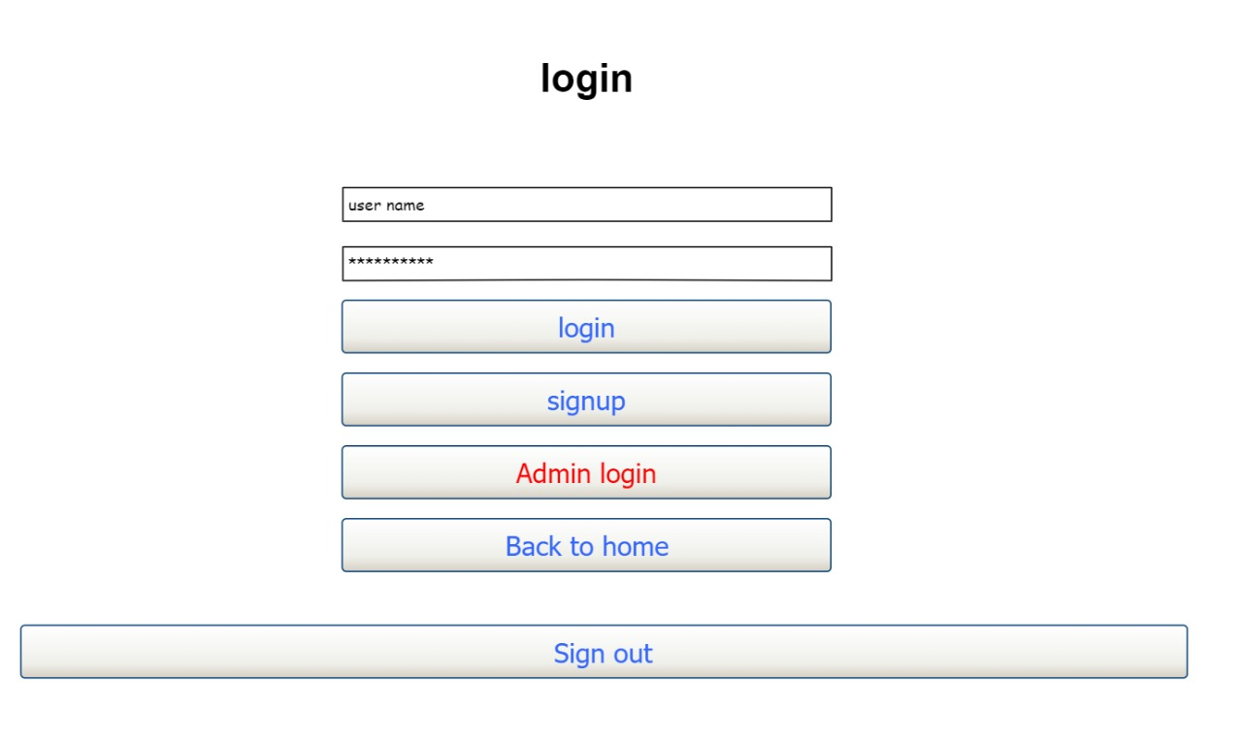
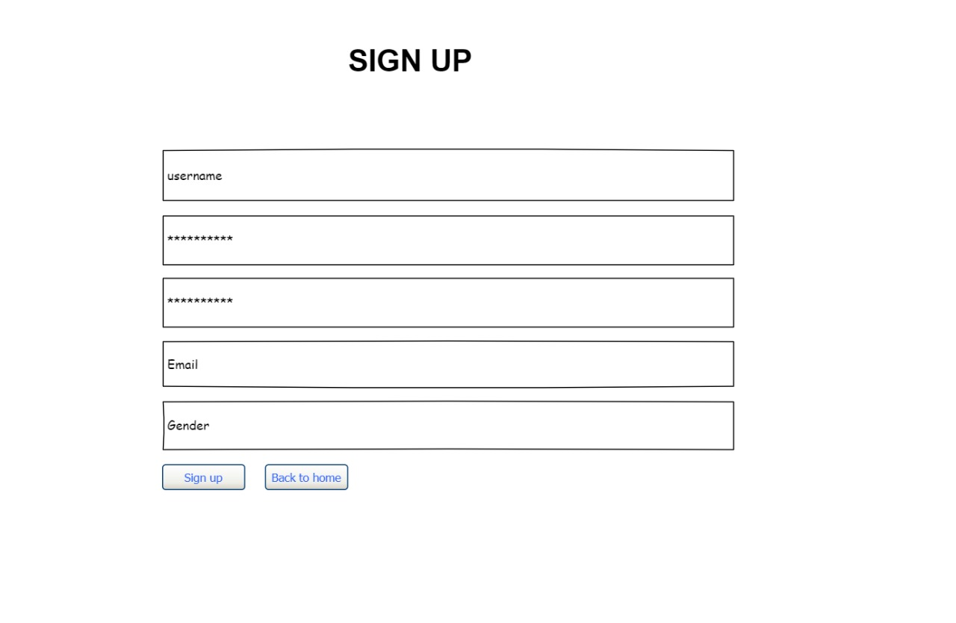
Login page

Slide 15
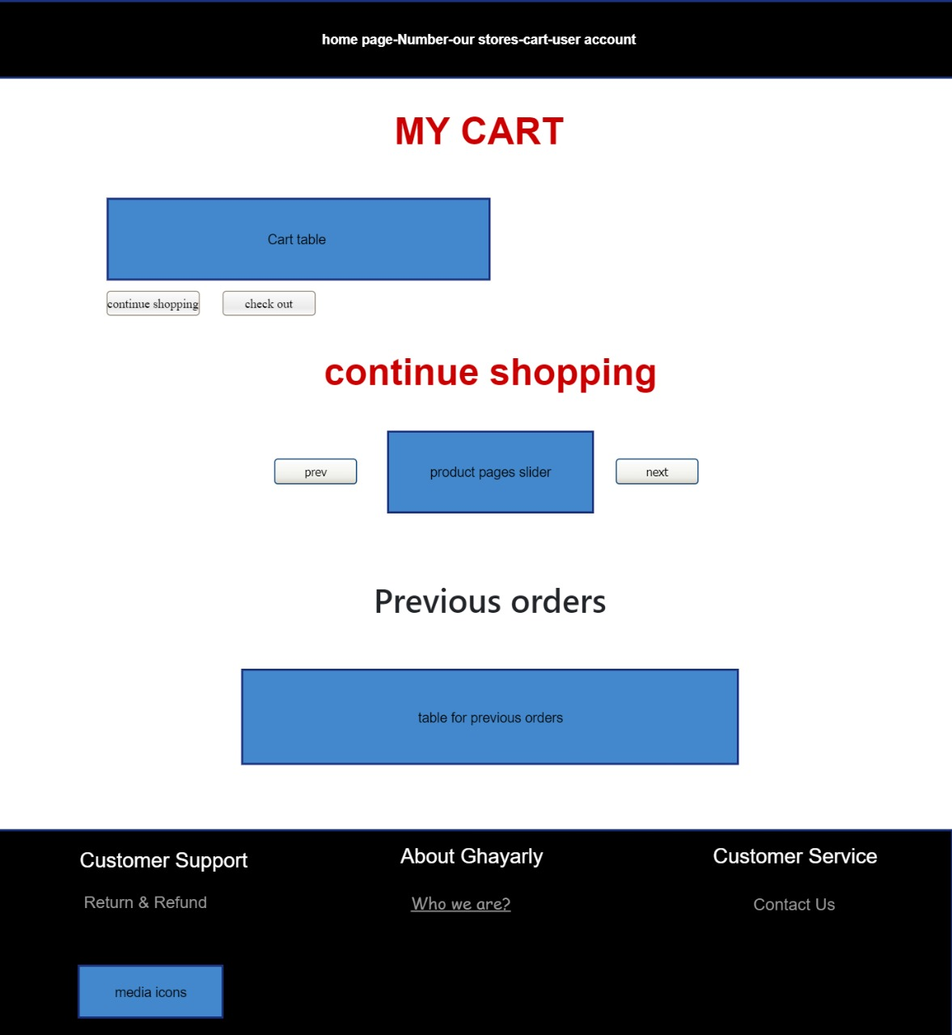
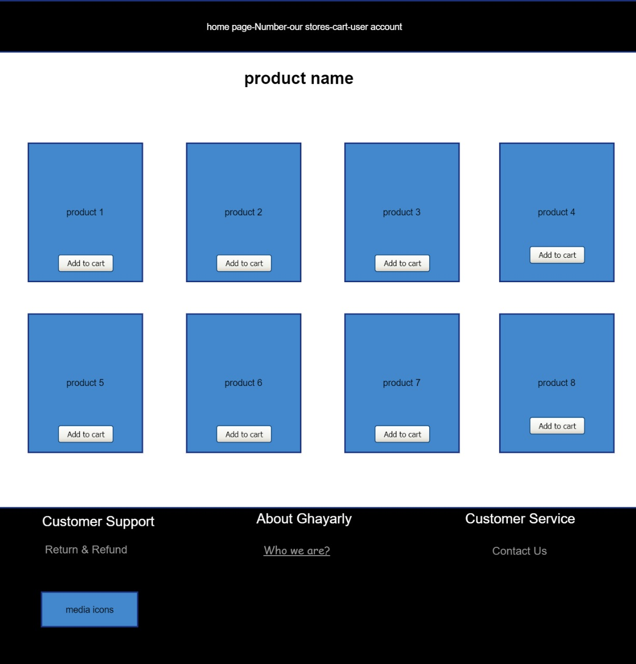
Cart page

Slide 16
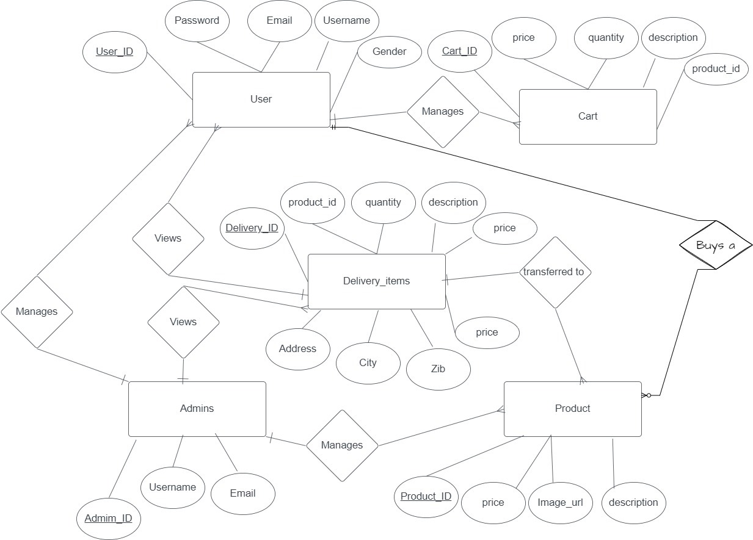
Erd

Slide 17
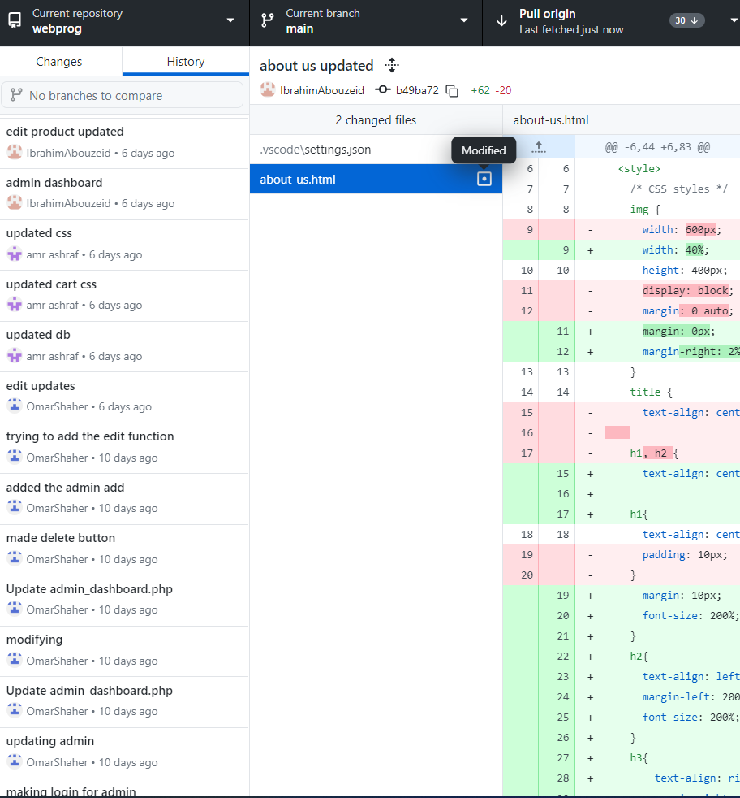
github

Slide 18
Thank you!

